Slide 1


Welcome to our
Year 2 SATS Meeting
31st January 2018

Slide 2

Outline
What are SATs?
An outline of the tasks and tests.
What can you do to help?

Slide 3

What are SATs?
National Curriculum Tests
KS1 SATs papers are taken during May by pupils in Year 2, who are working within the Key Stage 1 programme of study
The children will undertake tests in:
Reading
Mathematics
Grammar, Punctuation & Spelling***
In KS1 the emphasis is on teacher assessment, the tests support this judgement.
The children will not know that they are taking SATs. They will be administered as subtly as possible.

Slide 4
Teacher Assessment
Ongoing… ☺
Assessments include:
-Reading
-Writing
-Maths
-Science
Data has to be submitted before the end of June.
Results will be reported in July*

Slide 5
Tasks and Tests
English | Maths
Reading Paper 1: Combined reading prompt and answer book (30 minutes) Paper 2: Contains more challenging questions and a separate answer booklet (40 minutes) *Scaled score of 25 Grammar, Punctuation and Spelling Paper 1: Spelling Test (15 minutes) Paper 2: Questions – GPS (20 minutes) *Scaled score of 25 | Paper 1: Arithmetic test (20 minutes) Paper 2: Reasoning -mathematical fluency, problem-solving and reasoning (35 minutes) *Scaled score of 37

Slide 6




Reading
Children will complete two papers:
The texts will cover a range of fiction, non-fiction and poetry
Paper 1 consists of a selection of texts, with questions interspersed.
Paper 2 comprises a reading booklet of a selection of longer passages. The children will write their answers in a separate booklet.

Slide 7
Reading questions
There will be a variety of question types:
Multiple choice
Ranking/ordering -Number the events below
Matching –’Match the character to the job that they do in the story’
Labelling -‘Label the text to show the title’
Find and copy -‘Find and copy one word that shows what the weather was like in the story’
Short answer - ‘What does the bear eat?’
Open-ended answer -‘Why did Lucy write the letter to her grandmother? Give two reasons.’

Slide 8
Ants are insects that you can often see in a garden, in a park or just on the pavement. They usually live underground. The Queen ant spends all day laying her eggs.
What kind of animal is an ant? ______
Find and copy two places you might see ants? ___________ ___________
What does the queen ant do?
Keeps her nest clean lays eggs

Slide 9

GPS
Spelling, punctuation and grammar
Children will complete two short papers
Paper 1: Spelling Test of 20 words
Paper 2: Grammar, punctuation and vocabulary test

Slide 10
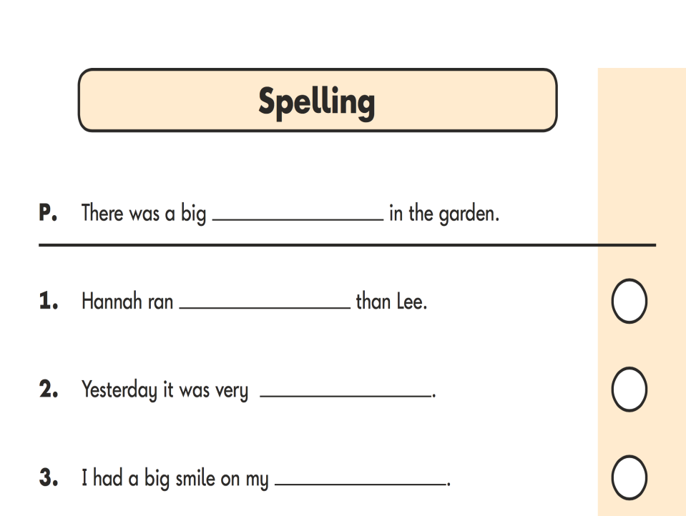


Slide 11
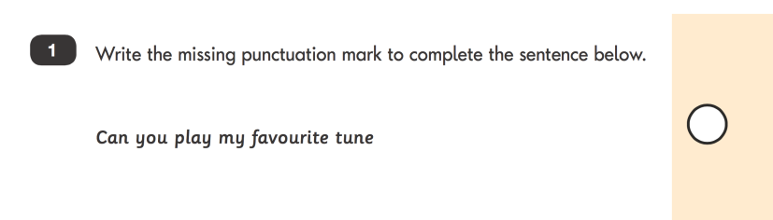
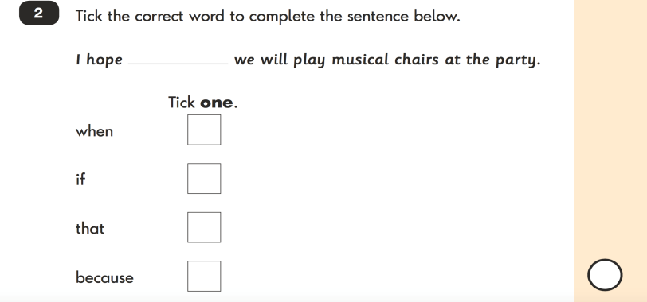

Slide 12
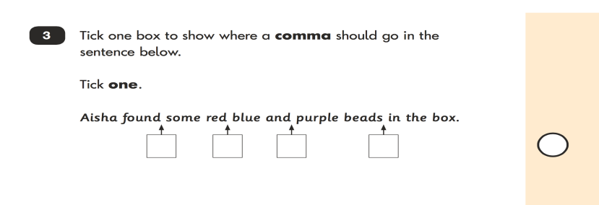
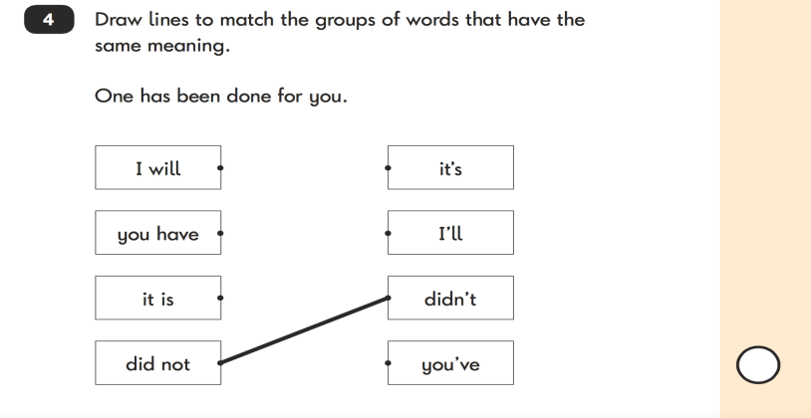

Slide 13


Mathematics
Mathematics SATs consist of;
Paper 1: Arithmetic test (15 minutes)
This will focus on the four main calculations.
Paper 2: Mathematical fluency, problem-solving and reasoning test (35 minutes)
variety of question types:
multiple choice,
matching,
true/false,
constrained (tables/charts)
less constrained (show a method/explain).

Slide 14




Slide 15
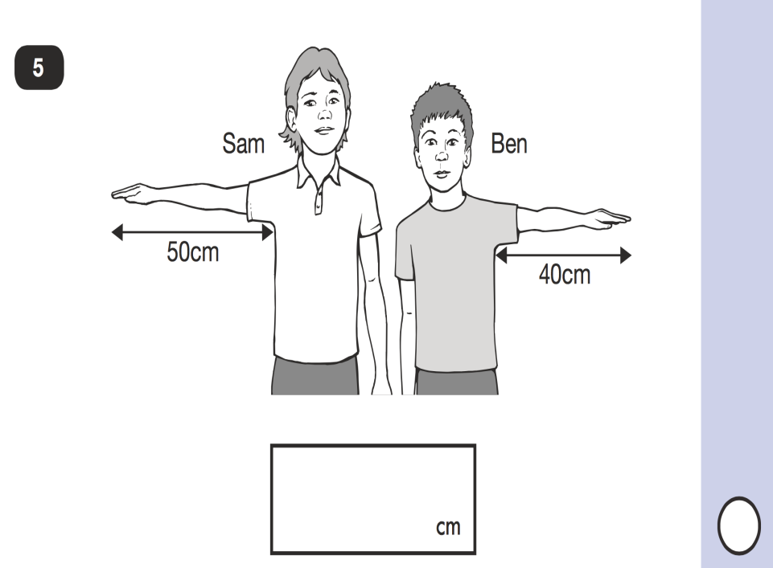

Slide 16
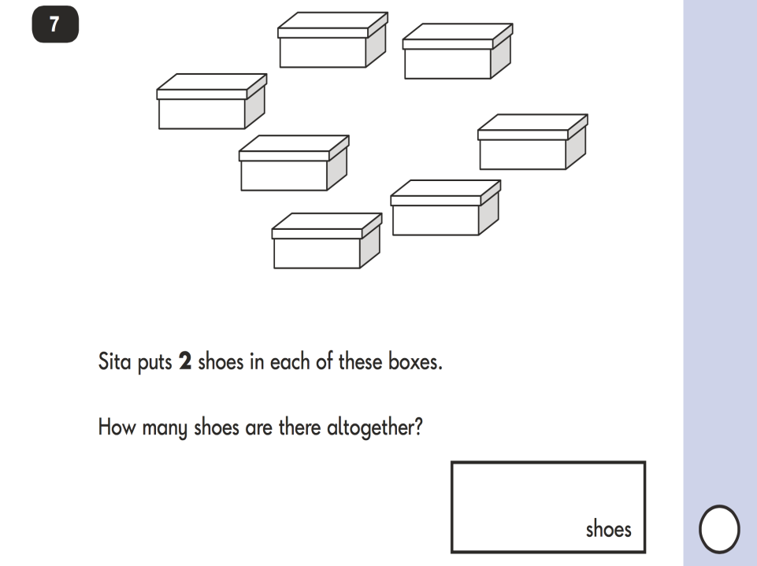

Slide 17
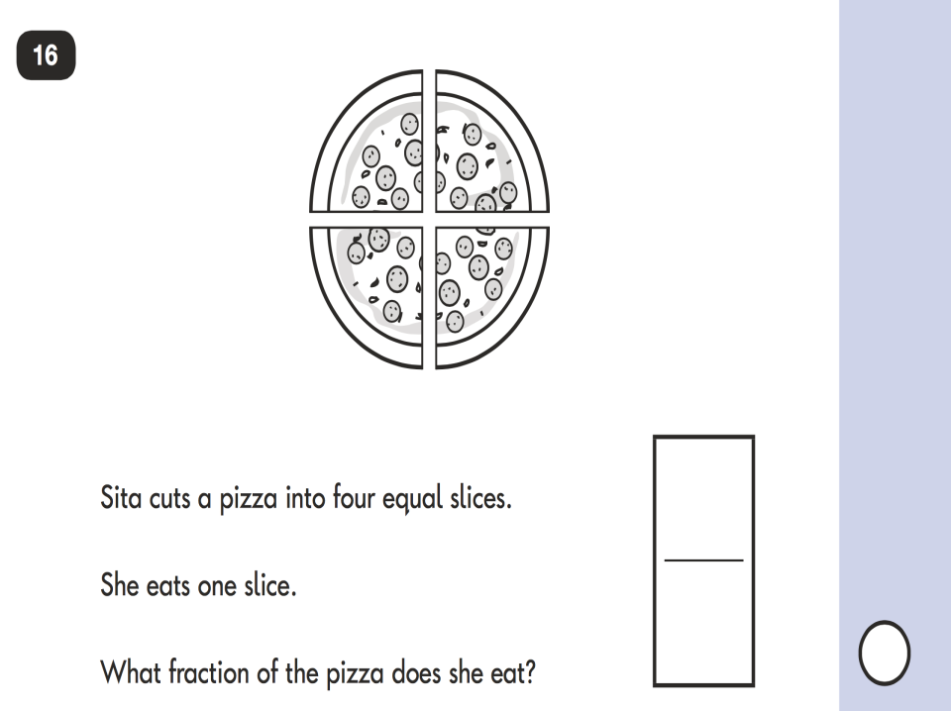

Slide 18

How can parents help?
Support with homework.
Good communication between school and home.
Getting a good sleep on a school night!
100% attendance as far as possible.

Slide 19

How can I help
with reading?
Listening to your child read can take many forms:
Enjoy stories together – reading stories to your child is equally as important as listening to your child read.
Read a little at a time but often, rather than rarely but for long periods of time!
Talk about the story before, during and afterwards – discuss the plot, the characters, their feelings and actions, how it makes you feel, predict what will happen and encourage your child to have their own opinions.
Look up definitions of words together – you could use a dictionary, the Internet or an app on a phone or tablet.
All reading is valuable – it doesn’t have to be just stories. Reading can involve anything from fiction and non-fiction, poetry, newspapers, magazines, football programmes, TV guides.
Visit the local library - it’s free!
Help them with the different skills of reading especially ‘skim’ reading, where they are looking for key words in the text.

Slide 20
How can I
help with writing?
Practise and learn weekly spelling lists – make it fun!
Encourage opportunities for writing, such as letters to family or friends, shopping lists, notes or reminders, stories or poems.
Write together – be a good role model for writing.
Encourage use of a dictionary to check spelling.
Allow your child to use a computer for word processing, which will allow for editing and correcting of errors without lots of crossing out.
Remember that good readers become good writers! Identify good writing features when reading (e.g. vocabulary, sentence structure, punctuation).
Show your appreciation: praise and encourage, even for small successes!

Slide 21
How can I help with maths?
Play times tables games.
Play mental maths games including counting in different amounts (forwards and backwards), recalling addition and subtraction facts, doubling and halving.
Encourage opportunities for telling the time.
Encourage opportunities for counting coins and money e.g. finding amounts or calculating change when shopping.
Look for numbers on street signs, car registrations and anywhere else.
Look for examples of 2D and 3D shapes around the home.
Identify, weigh or measure quantities and amounts in the kitchen or in recipes.
Play games involving numbers or logic, such as dominoes, card games, draughts or chess.

Slide 22
Useful Websites
Useful Websites for Year 2
http://www.topmarks.co.uk/maths-games/5-7-years
http://www.topmarks.co.uk/english-games/5-7-years
http://www.bbc.co.uk/bitesize/ks1/ English, Maths and Science
http://resources.woodlands-junior.kent.sch.uk/maths/interactive/
http://resources.woodlands-junior.kent.sch.uk/interactive/literacy.html
http://www.crickweb.co.uk/Key-Stage-1.html English, Maths and Science
http://www.coxhoe.durham.sch.uk/curriculum-links/numeracy/children
http://www.coxhoe.durham.sch.uk/curriculum-links/literacy
https://www.sumdog.com/ All Y2 children have usernames and passwords for this site
https://ttrockstars.com/login
https://www.purplemash.com/login/
https://www.gov.uk/government/collections/national-curriculum-assessments-practice-materials

Slide 23
Any Questions?
Thank you for coming along.
Please do not hesitate to contact us if there is anything we can do to help.
claire.henderson@shieldrow.durham.sch.uk

